Slide 1
OpenFabrics and UCX
Performance on the ARCHER2 HPE Cray EX system
Michael Bareford, William Lucas, Andy Turner
EPCC, The University of Edinburgh
www.archer2.ac.uk

Slide 2

Reusing this material
This work is licensed under a Creative Commons Attribution-NonCommercial-ShareAlike 4.0 International License.
https://creativecommons.org/licenses/by-nc-sa/4.0/
This means you are free to copy and redistribute the material and adapt and build on the material under the following terms: You must give appropriate credit, provide a link to the license and indicate if changes were made. If you adapt or build on the material you must distribute your work under the same license as the original.
Note that this presentation contains images owned by others. Please seek their permission before reusing these images.

Slide 3




Partners

Slide 4
Introduction
ARCHER2 is the latest UK National Supercomputing Service
Based around a large (750,000 core) HPE Cray EX system
Compare the performance of OpenFabrics and Mellanox UCX
Transport protocols that underly the MPI library on ARCHER2
Can be selected at runtime by users
Motivation:
Provide good advice to users on which protocol to choose and when
Understand the performance characteristics of Slingshot interconnect
Identify problems and areas for improvement – particularly at large scale

Slide 5
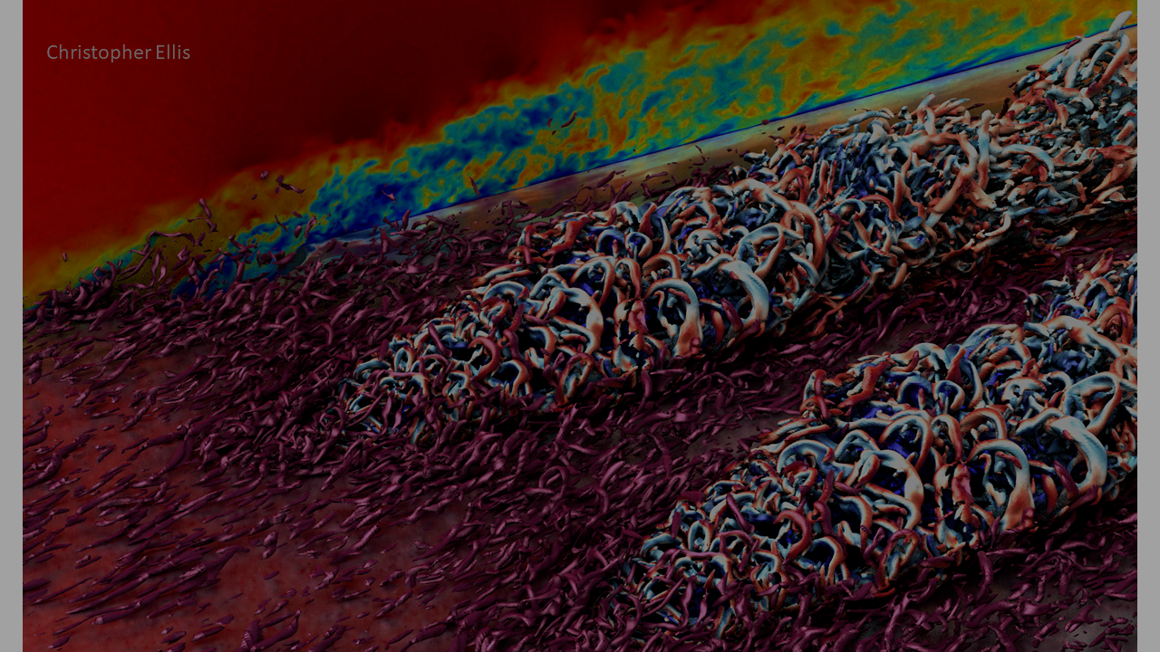
ARCHER2 Overview

Slide 6

UK National Supercomputing Service – based at EPCC at The University of Edinburgh
Service designed to enable world-leading research for a wide range of research areas in the UK
User base of over 3000 users
Aim to have at least 10x the research throughput of its predecessor (ARCHER) and provide new capabilities for researchers
Application Type | Approx. % Use | Example Applications
Quantum Materials Modelling | 40% | CASINO, CASTEP, CP2K, QE, VASP
Earth Systems Modelling | 20% | Met Office UM, MITgcm, NEMO, WRF
Computational Fluid Dynamics | 15% | OpenFOAM, Nektar++, SBLI, Code_Saturne
Biomolecular Modelling | 15% | GROMACS, NAMD
Classical Materials Modelling | 5% | LAMMPS
Plasma Physics | 3% | EPOCH, GS2, OSIRIS
Quantum Chemistry | 2% | NWChem, GAMESS
Huge range of software: top 10 codes ~50%, top 40 ~75%, 100s of others make up the rest

Slide 7
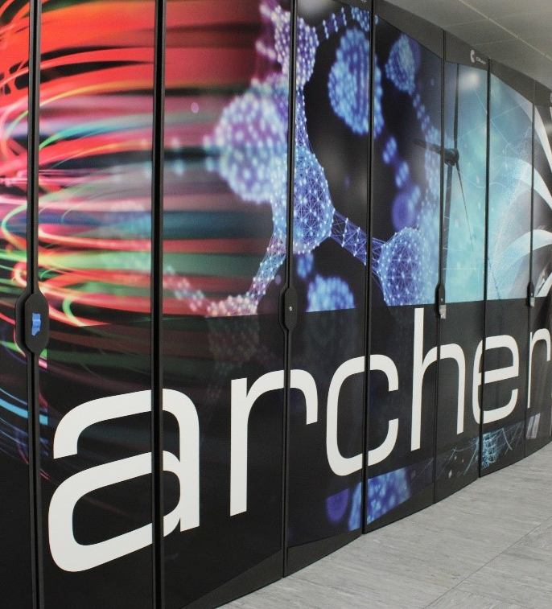
ARCHER2 system
HPE Cray EX Supercomputer
Hosted at EPCC, The University of Edinburgh
5,860 compute nodes (750,080 CPU compute cores)
HPE Cray Slingshot interconnect
Compute nodes:
Dual socket AMD EPYCTM 7742 (Rome), 64c, 2.25 GHz
256 GIB / 512 GiB memory per node
Two 100 Gbps Slingshot interfaces per node
3x ClusterStor L300 Lustre file systems, each 3.6 PB
1 PB ClusterStor E1000F solid state storage
Not available at start of service
Will be available to users via Slurm BB directives
4x NetApp FAS8200A file systems, 1 PB total

Slide 8
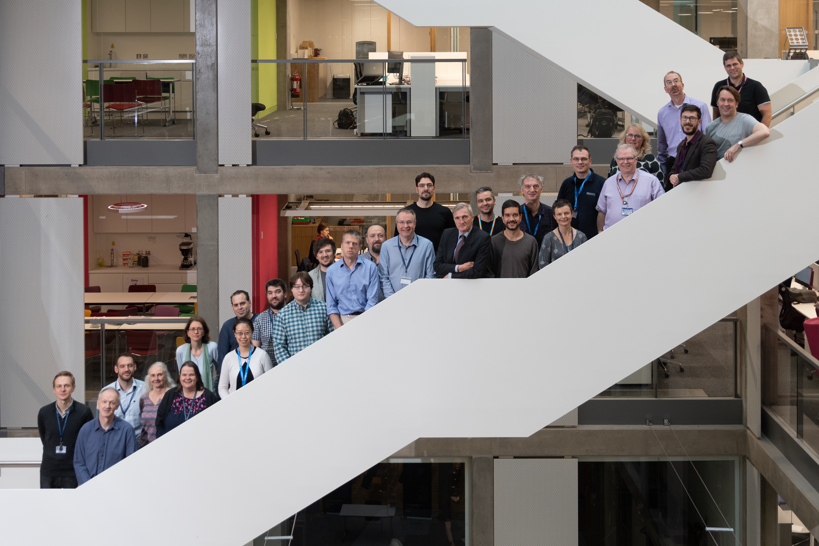
ARCHER2 Service
Comprehensive support for users from experts at EPCC and HPE
Extensive training programme that is free to researchers
Wide range of courses from entry level to advanced
Support to employ Research Software Engineers to improve codes
These can be RSEs in the community or provided by EPCC
Outreach and engagement with the public and wider research community

Slide 9
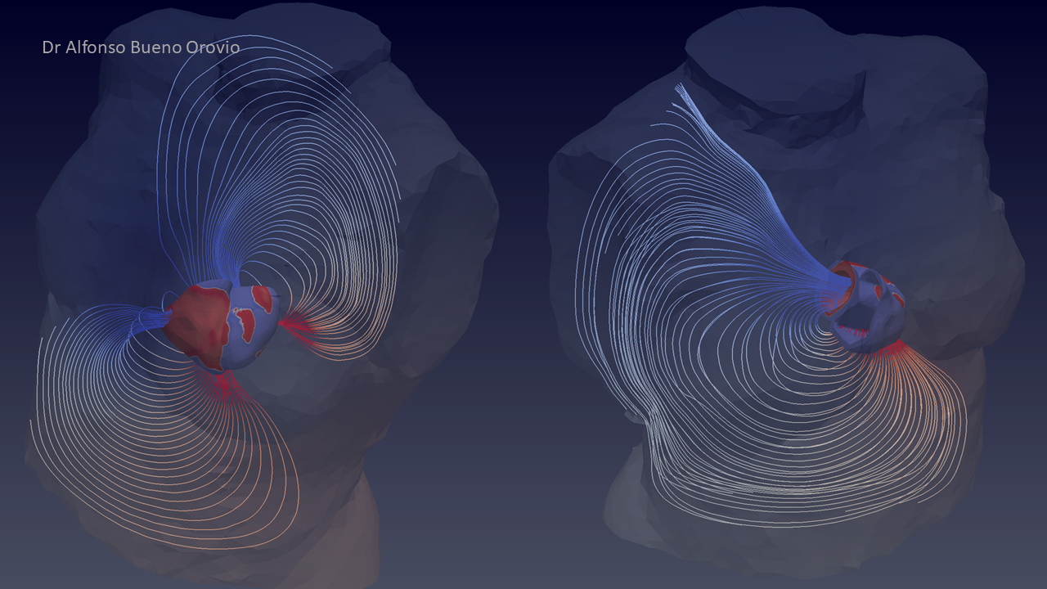
Benchmark details

Slide 10
Full details
Full details of the benchmarks available on Github:
https://github.com/ARCHER2-HPC/performance_ofi-ucx
Includes:
Benchmark descriptions and input decks
Job submission scripts
Build instructions and versions of software used
Raw results and outputs from benchmark runs
Output from profiles on different node counts (CrayPAT-lite)
Analysis scripts

Slide 11
Benchmarks
Synthetic:
Ohio State University (OSU) MPI micro-benchmarks
https://mvapich.cse.ohio-state.edu/benchmarks/
Applications:
CASTEP: plane wave DFT materials science
https://www.castep.org
CP2K: localised basis set DFT materials science
https://www.cp2k.org
GROMACS: classical biomolecular modelling
https://www.gromacs.org
OpenSBLI: CFD via domain specific language
https://opensbli.github.io/
VASP: DFT materials science
https://vasp.at/

Slide 12
Application benchmarks
CASTEP:
Large DNA benchmark
MPI_Alltoallv
CP2K:
LiH exact exchange
[ScaLAPACK/BLACS, need to look closer at this]
GROMACS:
[Calculation details]
Point-to-point MPI communications
OpenSBLI:
Taylor-Green vortex calculation
Point to point MPI communications
VASP:
TiO2 supercell, pure DFT
MPI_Alltoallv, MPI_Allreduce

Slide 13
Build environment summary
System software: Shasta 1.4
HPE Cray Programming Environment (CPE) 21.09
HPE Cray MPICH 8.1.9
OpenFabrics: 1.11.0.4.71 (libfabric)
UCX: 1.9.0 (from Mellanox HPCX 2.7.0)
Compilers:
GCC 11.2.0: OSU MPI, CASTEP, CP2K, GROMACS, VASP
CCE 12.0.3: OpenSBLI
Other CPE components
FFTW 3.3.8.11: CASTEP, CP2K, VASP

Slide 14

Results and analysis

Slide 15
CASTEP

Slide 16
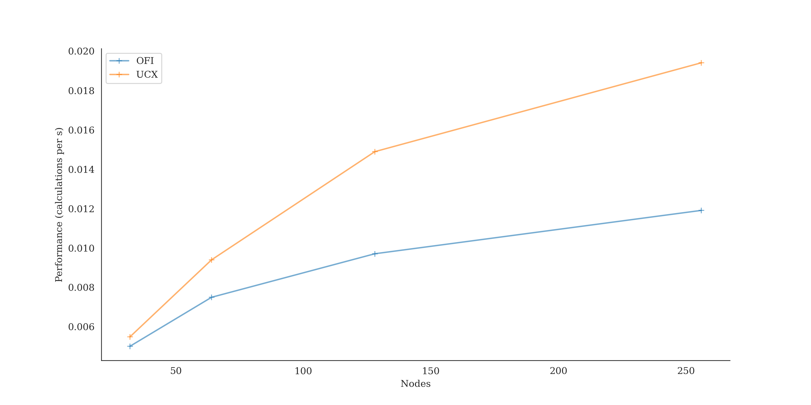
CP2K: performance

Slide 17
CP2K: profile
Nodes | OFI | UCX
64 | Runtime: 419.0s 16.3% MPI 5.5% Alltoallv 3.4% Waitall 3.0% Barrier 2.3% Allreduce | LOOP+: 421.0s 11.8% MPI 3.5% Waitall 3.2% Barrier 2.8% Allreduce
128 | Runtime: 103.082s 19.8% MPI 6.4% Barrier 5.3% Alltoallv 2.7% Allreduce 2.6% Waitall 1.1% Isend | Runtime: 67.164s 14.9% MPI 6.6% Barrier 3.3% Allreduce 3.0% Waitall
Much better scaling with UCX
MPI_Alltoallv appears in profiles for OFI but not UCX

Slide 18
GROMACS

Slide 19
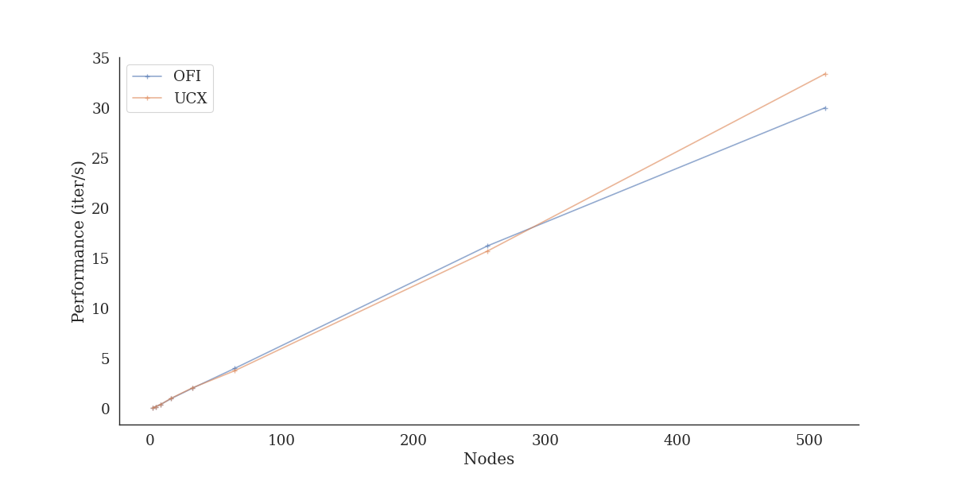
OpenSBLI: performance

Slide 20
OpenSBLI: analysis
Nodes | OFI | UCX
32 | Iteration: 0.483s 22.1% MPI 21.5% Waitall | Iteration: 0.475s 26.4% MPI 26.3% Waitall
256 | Iteration: 0.061s 42.1% MPI 40.2% Waitall 1.0% Isend | Iteration: 0.058s 38.0% MPI 37.3% Waitall
Performance and scaling very similar for OFI and UCX
Profiles shows similar timings between OFI and UCX
MPI parts are based around point-to-point comms and are not critical to scaling
The MPI_Waitall calls are part of calculation initialization and can be reduced by running for longer

Slide 21
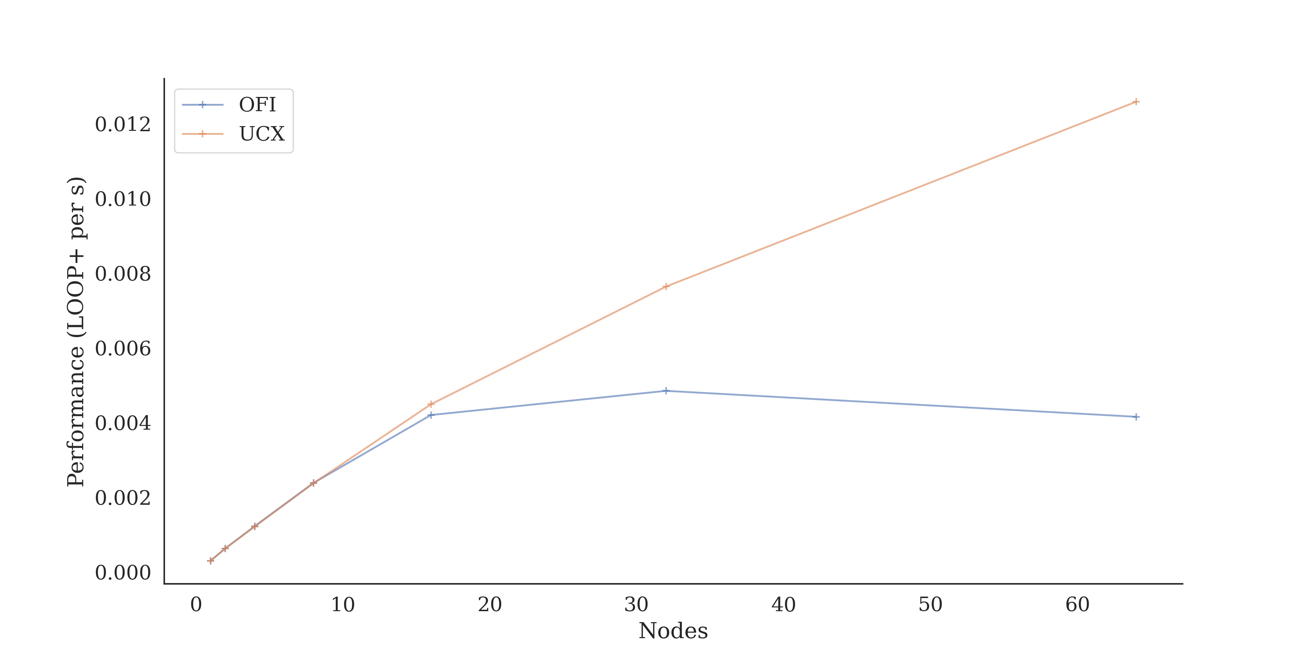
VASP: performance

Slide 22
VASP: analysis
Nodes | OFI | UCX
8 | LOOP+: 419.0s 27.7% MPI 8.3% Alltoallv 7.9% Bcast 5.1% Allreduce 4.6% Barrier | LOOP+: 421.0s 28.8% MPI 9.6% Bcast 5.2% Alltoallv 4.9% Barrier 4.6% Allreduce 4.5% Alltoall
64 | LOOP+: 240.5s 60.5% MPI 43.2% Alltoallv 7.2% Bcast 5.6% Allreduce 4.0% Barrier | LOOP+: 79.4s 50.4% MPI 22.0% Bcast 10.2% Barrier 8.5% Allreduce 7.7% Alltoall 2.1% Alltoallv
Much better scaling with UCX version above 16 nodes
For OFI, MPI_Alltoallv becomes the dominant routine as number of nodes increases
Same behaviour is not seen for UCX version

Slide 23
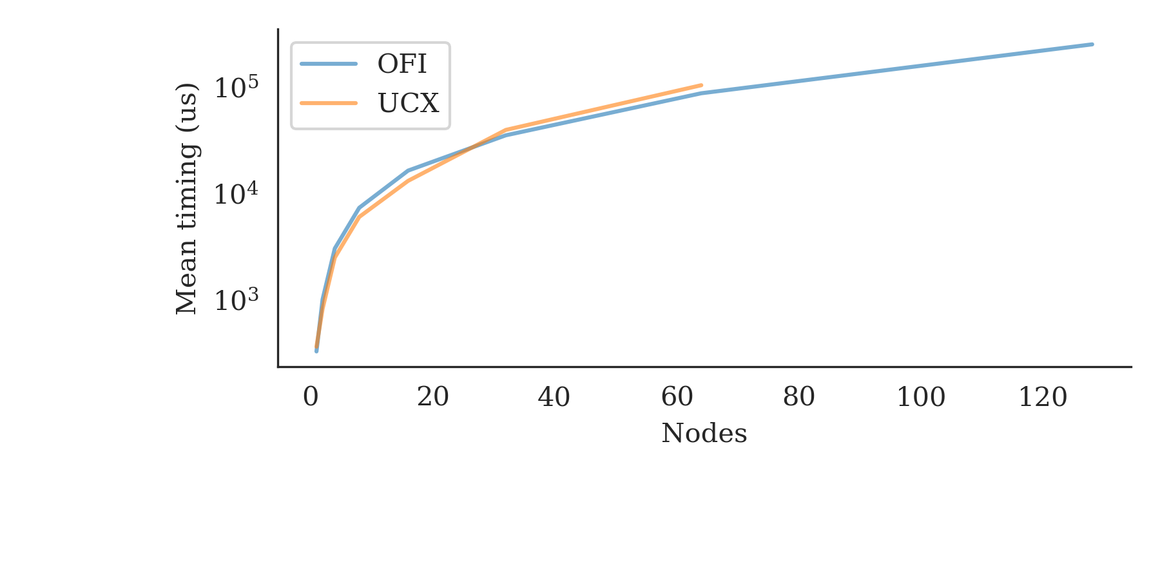
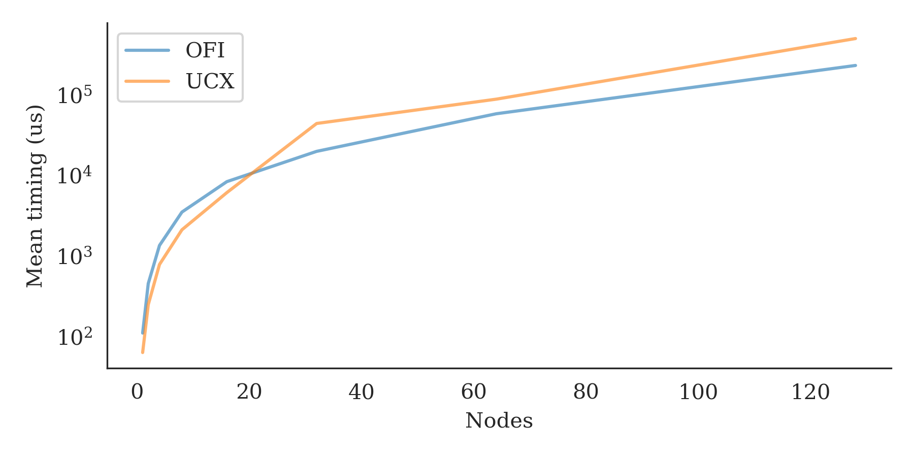
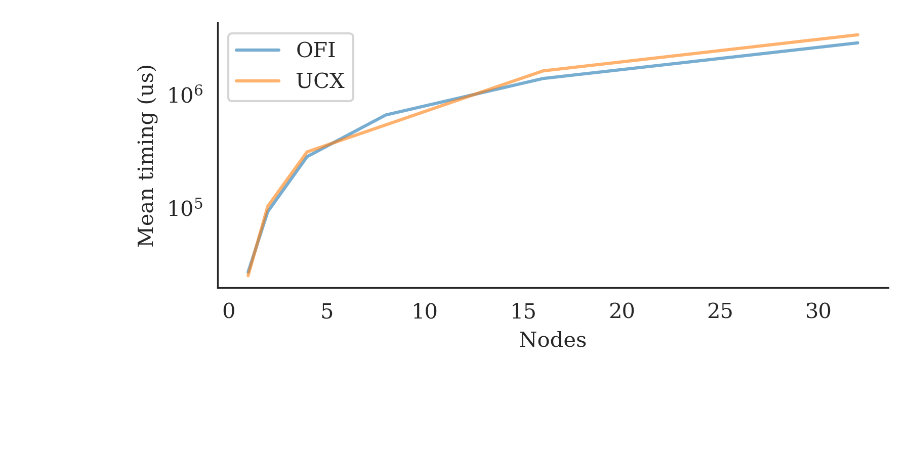
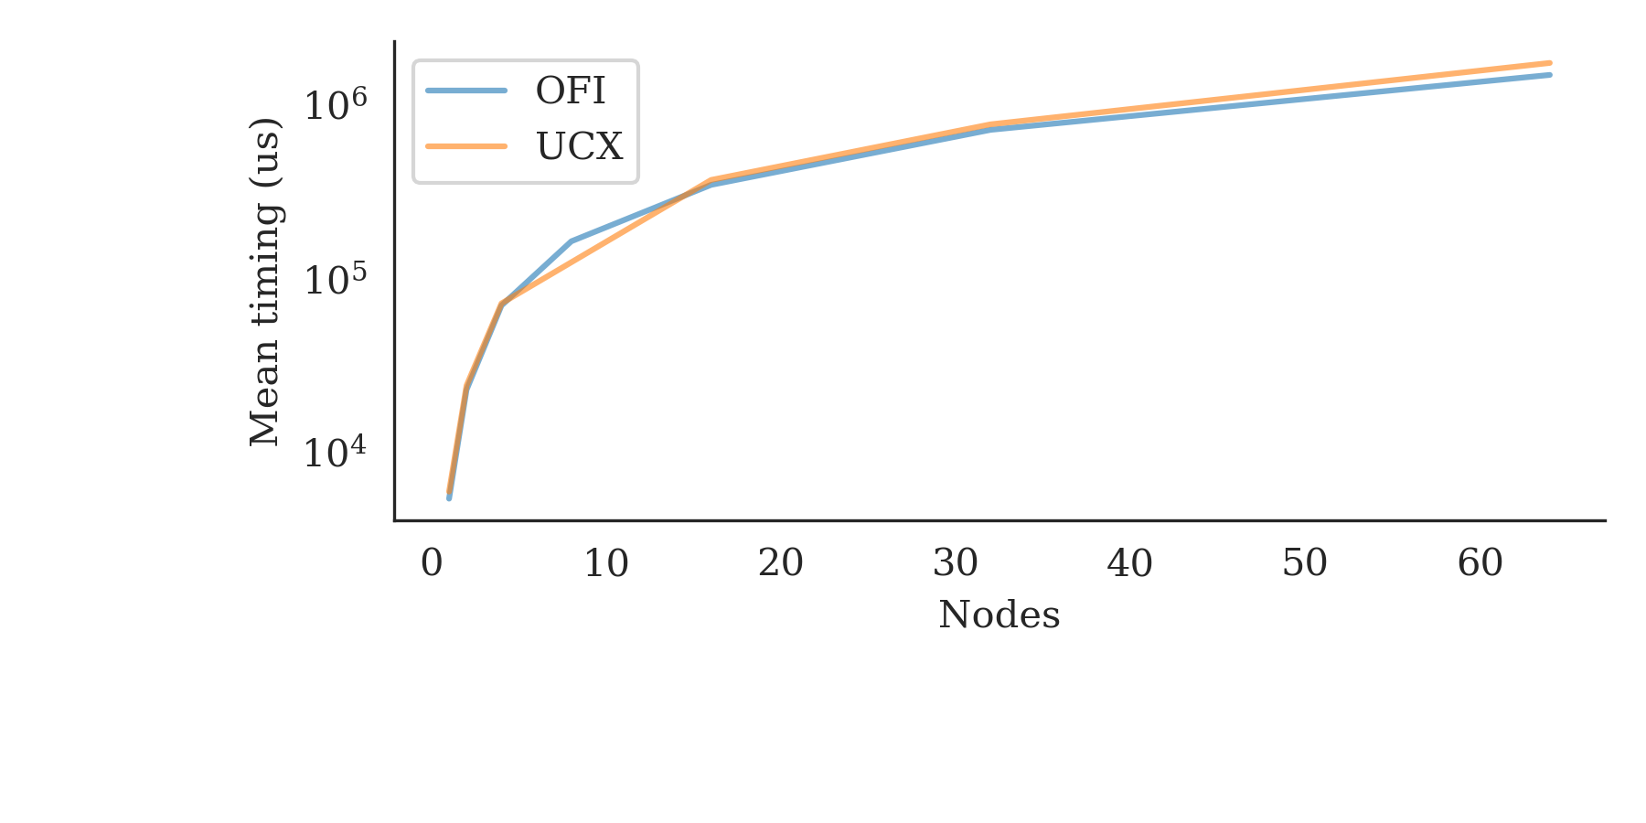
OSU micro-benchmarks: MPI_alltoallv
4 bytes
1024 bytes
32768 bytes
131072 bytes

Slide 24
OSU micro-benchmarks
Basic MPI_Alltoallv benchmarking shows little difference between OFI and UCX performance across a range of message sizes
Does not tally with the differences in performance seen for CP2K and VASP where reduced OFI scaling/performance seems linked to slower MPI_Alltoallv operations
More detailed analysis needed to look at how the benchmarks are using MPI_Alltoallv and why the differences are not reflected in OSU micro-benchmarks

Slide 25
Next steps and summary

Slide 26
Next steps
Further investigations of the characteristics of MPI_Alltoallv use in application benchmarks to better understand the performance issues for OFI
Can we find a synthetic benchmark that demonstrates the issues?
Extend to larger node counts
Repeat tests as system software is updated (Shasta version, Slingshot software, MPI library)

Slide 27
Summary
The choice of the OpenFabrics or UCX transport protocol can have a large effect on application performance
Particularly large effects have been observed for benchmarks that use MPI_Alltoallv collective operations
Using UCX typically gives much better performance/scaling than OFI in these cases
The effect is not seen in OSU MPI_Alltoallv micro-benchmarks
Benchmarks that rely on point-to-point MPI routines show much smaller variation

